Slide 1
Crop-Aware Panoptic Segmentation
Mehdi Naouar, Ben Bausch, Yannick Vogt

Slide 2
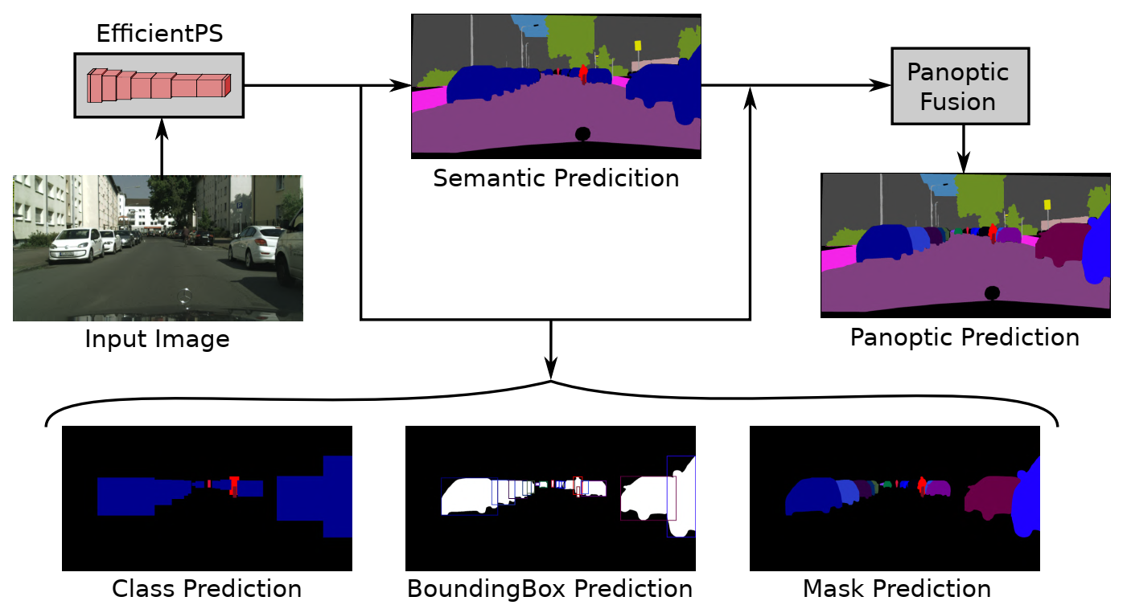
Panoptic Segmentation
[1]
Notes:
What is Panoptic Segmentation?
Whats the goal?
Rohits Paper

Slide 3

Bounding Box Prediction
Region Proposal Network proposes anchor boxes
Fully Connect Layer regresses transformations applied to the anchor to fit the ground truth Bounding Box
Smooth-L1 Loss

Slide 4
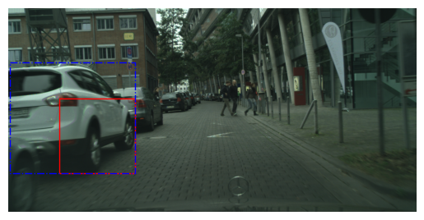
Bounding Box Example
Ground Truth, Anchor Box

Slide 5
Motivation
Full-size images consume too much memory
Resized images can’t represent fine structures
Idea: Train on crops

Slide 6
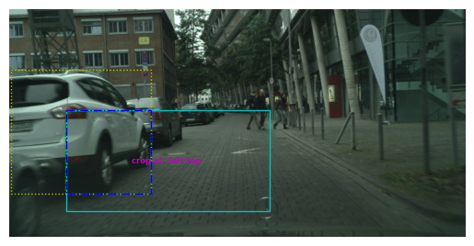
Crop Based Training
Allows training of larger networks or higher batch size
Fine structures can be preserved
Large objects might be truncated

Slide 7
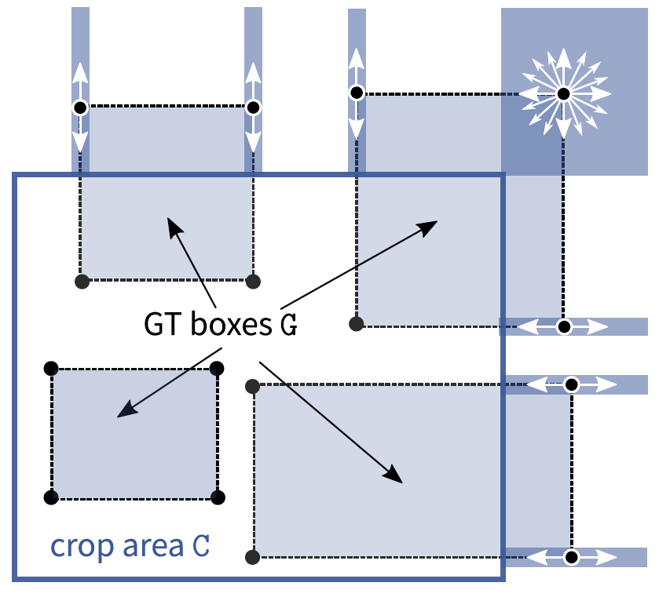
Crop-Aware Bounding Boxes (CABB)
Network is allowed to “hallucinate”
Can improve performance on objects which were cropped in training
[2]
Notes:
Explain cases
only outside can be modified

Slide 8
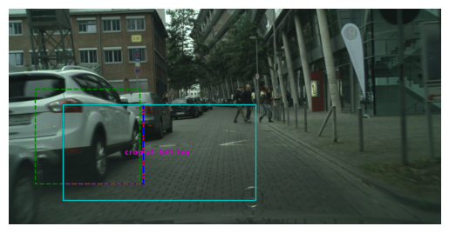
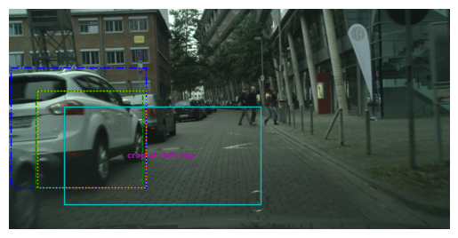
Visualization of CABB
Without CABB
With CABB
Ground Truth, Prediction, Crop Area, Anchor Box, CABB Target
Notes:
TODO add loss values here
With CABB is an adapted version is a greater equal in SOLVE O1
Left ground truth is cropped
We save the original gt
Right side we optimize a new target that minimizes loss based on cases
Explain colors

Slide 9
Training Setting
1024*512 Image size, 512*256 Crop size
8 Image per Batch on a single GPU
100 epochs of training with 2975 training images

Slide 10
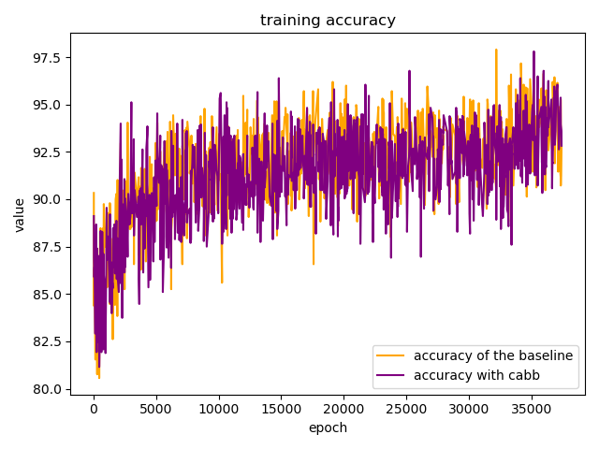
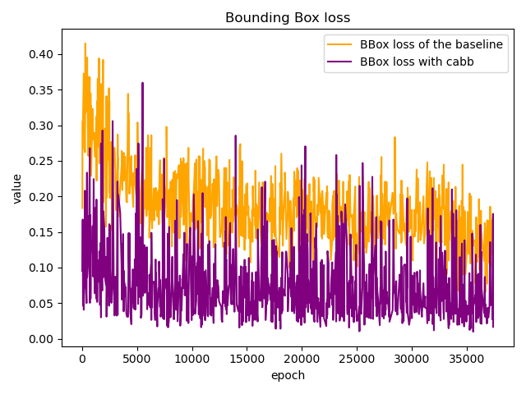
Training Results
39.5h for baseline vs 20.75h for the baseline

Slide 11
Test Results
Test models at epoch 100 on 500 full-sized images
Base | PQ | SQ | RQ | N
All | 47.6 | 75.5 | 60.9 | 19
Things | 42.0 | 75.1 | 55.8 | 8
Stuff | 51.7 | 75.8 | 64.5 | 11
CABB | PQ | SQ | RQ | N
All | 46.1 | 74.9 | 59.2 | 19
Things | 38.2 | 72.7 | 52.1 | 8
Stuff | 51.9 | 76.5 | 64.4 | 11

Slide 12
Sources
[1] Rohit Mohan, Abhinav Valada. EfficientPS: Efficient Panoptic Segmentation. arXiv:2004.02307v3, 2021
[2] Lorenzo Porzi, Samuel Rota Bulò, Peter Kontschieder. Improving Panoptic Segmentation at All Scales. arXiv:2012.07717v2, 2021

Slide 13
Thank you for your attention!

